Slide 1
NCWG Baseline Symbology Project Team (BSPT) Virtual Conference (VTC) Meeting - 3 19 January 2022 - 12.00 to 14.00 UTC.
Project Plan Creation

Slide 2

Potential Steps and timeframe
VTC 1 – March 2021
Creation of the BSPT Workplan
Workplan Submission to NCWG (end of January 2022)
Convert some symbology to .SVG
(March/April 2022)
Start assessment portrayal rules
(Late Summer 2022)
*BSPT to start some preliminary work
(Feb. 2022)
NCWG to submit the BSPT- Workplan to HSSC (February 2022)
Review the converted .SVG symbology
(May/June 2022)
Test the visualization of symbology with the Software producer
(Early Fall 2022)
Present some results @ NCWG 8 (November 2022)
Evaluate next steps
(December 2022)
VTC 3 – TOR
14 December 2021
VTC 3 - 19 January 2022 @ 1200 UTC
* Find a suitable base symbology dataset that could be converted.

Slide 3
Term of Reference (TOR)
Acceptance by NCWG
One comment from France

Slide 4
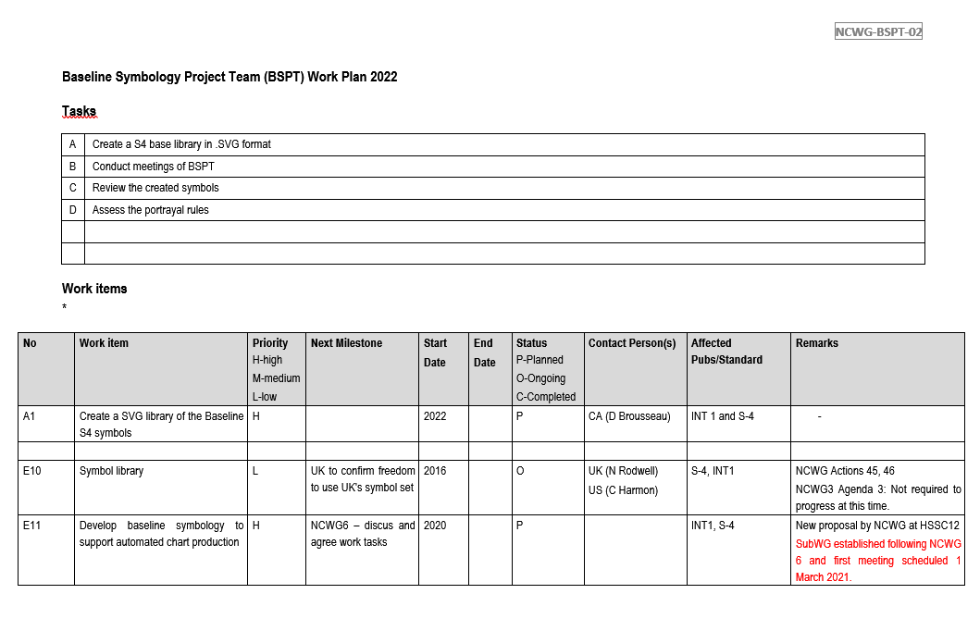

Slide 5
To be decided:
Higher level Workplan for HSSC.
Project Plan: (timeframe)
Details work structure for the PT to follow and work from.
-Project team document: break down structure.
- See Colby document that he presented.
- Convert a symbol library, Canada UKHO, Sweden, etc. To have as a working base of information.
Agree on S-4 Symbol and simplify the list
- - Implement in work tools/software for testing and visual reviews
- ⁃ Finalize
- ⁃ Submit to Secretariat
Potential dates:
- Symbols: Summer/Fall 2022
- Rules by Next Winter 2023.
Timeframe? Early Summer 2022 and present before (VTC) or at NCWG 8?

Slide 6
Review Document provided by Colby
Return comments by the 26th January 2022
Next meeting: VTC 4 - February 16th 2022
Invites to be sent for all future meetings until October 2022

